Slide 1
Chapter 12 A First Look at GUI Applications
Dustin Wolf
Spring 2015

Slide 2
Introduction
Many java applications use a graphical user interface (GUI)
A GUI is a graphical window(s) that provide interaction with the user.
GUI accept input from the keyboard and a mouse
A window in a GUI consists of components that
Present data to the user
Allow interaction with the application

Slide 3
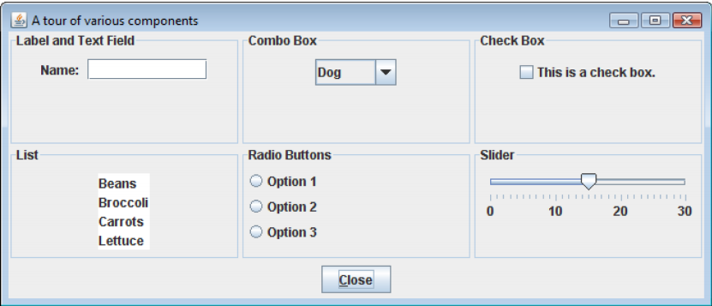
Introduction
Example GUI Components:
Button, labels, text fields, checkboxes, radio buttons, combo boxes, sliders…
Example from pearson website.

Slide 4
Java Foundation Classes
Use JFC to create GUI applications
Two classes that are focused on are AWT and Swing
AWT (Abstract Windowing Toolkit) allows the creation of applications and applets with GUI components.
Swing is a library of classes that provide an improved alternative for creating GUI applications and applets

Slide 5
AWT
The awt applications look consistent with other applications on the same system
Can only offer components that area common to all the OSs that support Java
Cannot easily extend the AWT
Components: Heavy Weight Components.

Slide 6
Swing
Introduced with the release of Java 2
Lightweight components, rely less on peer classes (unlike AWT)
Swing components have a consistent look and have predictable behavior on any OS
Swing can be easily extended

Slide 7
Swing and AWT packages
In order to use Swing classes
import javax.swing.*;
In order to use AWT classes
import java.awt.*;
Note the x on swing and lack of x on java.awt
The * means you are in including all of the classes within that directory

Slide 8
Tic Tac Toe
Go to course website and download the TicTacToe source files.
You need them to follow along.
The Tic Tac Toe application is a console program that needs to be converted into a graphical application.
The window needs to consist of 9 squares and a status bar that indicates the current players move.
The algorithm for playing the game is already included.

Slide 9
Creating Windows
In TicTacToeGUI.java
You will notice that the class extends the JFrame class.
public class TicTacToeGUI extends JFrame
Applications consist of containers
Component that holds other components
A container that is displayed as a window, is a frame
In a swing app, a frame is created using the JFrame class.

Slide 10
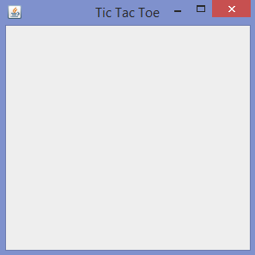
Creating Windows
A frame is a basic window that has a border, a title bar, and buttons for min max and closing
public TicTacToeGUI()
{
setTitle("Tic Tac Toe");
setSize(300, 300);
setDefaultCloseOperation(JFrame.EXIT_ON_CLOSE);
setVisible(true);
}

Slide 11
Adding Components
Swing provides numerous components that can be added to a window.
Three fundamental components are:
JLabel : area that can display text
JTextField: an area in which a user can enter text from the keyboard
JButton: a button that can be clicked.
It is not limited to these components.

Slide 12
Adding Components
In the TicTacToe project you are required to use 9 buttons and a label.
private JButton[] buttons;
private JLabel status;
status = new JLabel("");
for(int i = 0; i< 9; i++)
buttons[i] = new JButton("");
Example of declaring and instantiating these components

Slide 13
Adding Components
A content pane is a container that is part of every JFrame object
Every component must be added to the content pane if adding to the JFrame.
Content Pane is not visible.
Another component that is a container is the JPanel.
The Content Pane as a contain is mandatory, whereas using the JPanel is only optional.

Slide 14
Adding Components
JPanel
cannot be displayed by themselves
used to hold and organize
To use them:
private JPanel board;
…
board = new JPanel(new GridLayout(3,3));
board.add(new JButton(“”));

Slide 15
Layout Managers
An important part of designing a GUI application is deciding the layout of the components.
The term Layout refers to the positioning and sizing of components.
In Java, you do not need to specify the exact location of a component.
A layout manager is an object that controls the position and size of the components and makes the adjustments whenever necessary.

Slide 16
Layout Managers
FlowLayout – arranges components in rows, this is default
BorderLayout – arranges components in 5 regions, (default for JFrame’s content pane)
North, South, East, West, Center
GridLayout – arranges components in a grid with rows and columns
Two ways to use:
JPanel jp = new JPanel();
Jp.setLayout(new GridLayout(3, 3));
JPanel jp =
new JPanel(new GridLayout(3, 3));

Slide 17
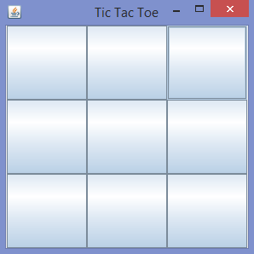
Adding Components
After creating the JPanel you can add it to the frame using the super call .add()
add(board);
After that this is what you will see:

Slide 18
Event Driven Programming
A program that operates in a GUI environment MUST be event-driven.
An event is an action that takes place within a program, such as a click of a button
Part of GUI application development is creating event listeners
Event Listener: object that executes one of its methods when a specific event occurs

Slide 19
Event Listeners
When you write a class for listeners, you MUST implement an interface.
JButton component generates action events, which require the action listener class
Action listener classes must meet the following requirements:
Implement the ActionListener interface
It must have a method named actionPerformed.
actionPerformed takes an argument of ActionEvent type

Slide 20
Event Listeners
class ButtonListener implements ActionListener
{
@Override
public void actionPerformed(ActionEvent e) {
String command = e.getActionCommand ();
}
}
JButton button = new JButton(“”);
button.setActionCommand(Integer.toString(id));
button.addActionListener(new ButtonListener());

Slide 21
Fore(Back)ground Color
Many of the Swing component classes have methods named
setBackground
setForeground
setBackground: changes the color of the background of the component
setForeground: changes the color of the text of the component
The color is part of the Color class: Color.BLACK

Slide 22
setBackgroundColor
Referring back to our Tic Tac Toe, within the actionPerformed:
if(turn % 2 == 0){
buttons[index].setBackground(Color.BLUE);
}
else{
buttons[index].setBackground(Color.RED);
}

Slide 23
Putting It All Together
Go through all of the todo’s on the TicTacToeGUI.
Feel free to ask questions as we go through it.

